Slide 1
Intro to java Programming and Software architecture
Jaden bottemiller

Slide 2
Team organization

Slide 3
Github and file organization
File organization
It is a common issue in a development team to maintain one, updated copy of their project
In order to make programming as a team easier, all updates to code must be recorded
GitHub
GitHub is a program that will allow us to track versions of our code and sync them all together wherever we are when coding.

Slide 4
More on GitHub
Register and add to project
Norms:
ALWAYS sync the files from GitHub to your local machine BEFORE modifying code.
ALWAYS record changes when uploading code.

Slide 5
Computer Programming in JAVA
Java Linguistics

Slide 6
Basic Java programming and computer science concepts
Basic program conceptualization
Instructions to the computer (function calls, function creation)
Variables and data typing
Object Oriented Programming (classes, methods, properties)
Variable scope and accessing object properties
Conditionals, conditional statements, conditional iterative loops
Notes:
Won’t go over arrays– too much content, not enough time. Or big O() notation – not that it’s very important anyway

Slide 7
How does a program run?
A program runs just like we would read a book, one line at a time.
There are three aspects of running a program:
Semantics – These define the meaning of certain statements in a language.
“I’m having a friend for dinner,” can mean two different things– this isn’t allowed in CS
Static Semantics – The meaning of a syntactically correct statement
“I are big,” this is syntactically correct, but it is not grammatically (or “static semantically”) correct
Syntax – This defines what a correctly coded program looks like in the IDE (e.g. the form of the language: using semicolons at the end of lines and putting curly braces around functions and objects, or the order in which we put statements)
“hat a had I,” is incorrect syntax; “I had a hat” is correct – The concept is similar in computer science

Slide 8
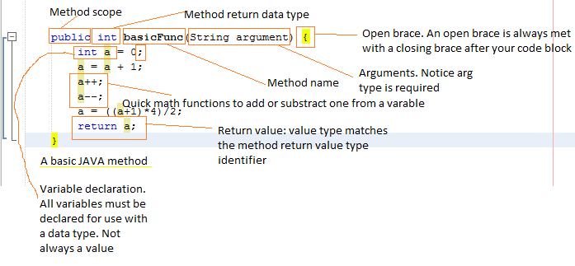
Basic Java syntax and semantics
Notes:
We shouldn’t know all of this, we’ll come back to this multiple times later.

Slide 9
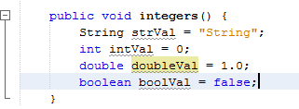
Variables and data typing
We use variables as place holders for raw values.
Variables are useful since we don’t always know what a computation will end up being, so we need to assign the answer to a variable
They allow us to easily alter values in a program, without having to change every instance of that value
Spelling is key
There are different types of variables
We have to instantiate a variable by declaring its type, its name, and a default value (in most cases), but we only have to do that once per variable in our code
Notes:
Object properties do not need default values.

Slide 10

Functions
Functions are groups (“blocks”) of code that runs to perform a specific operation
Functions can take arguments/parameters to perform an operation
Functions can return a value, but they do not have to
Returning a value means to give the value of the return variable back to where it came from.
They are useful to reduce the amount of code and to make it easier for one to change specific operations in a large project (an example of code modularization)
If a function’s return data type is “void,” then it does not return a value
Notes:
Notice the singleton pattern on the Calendar class. The getInstance() method is actually returning another object and that object has the method get()

Slide 11
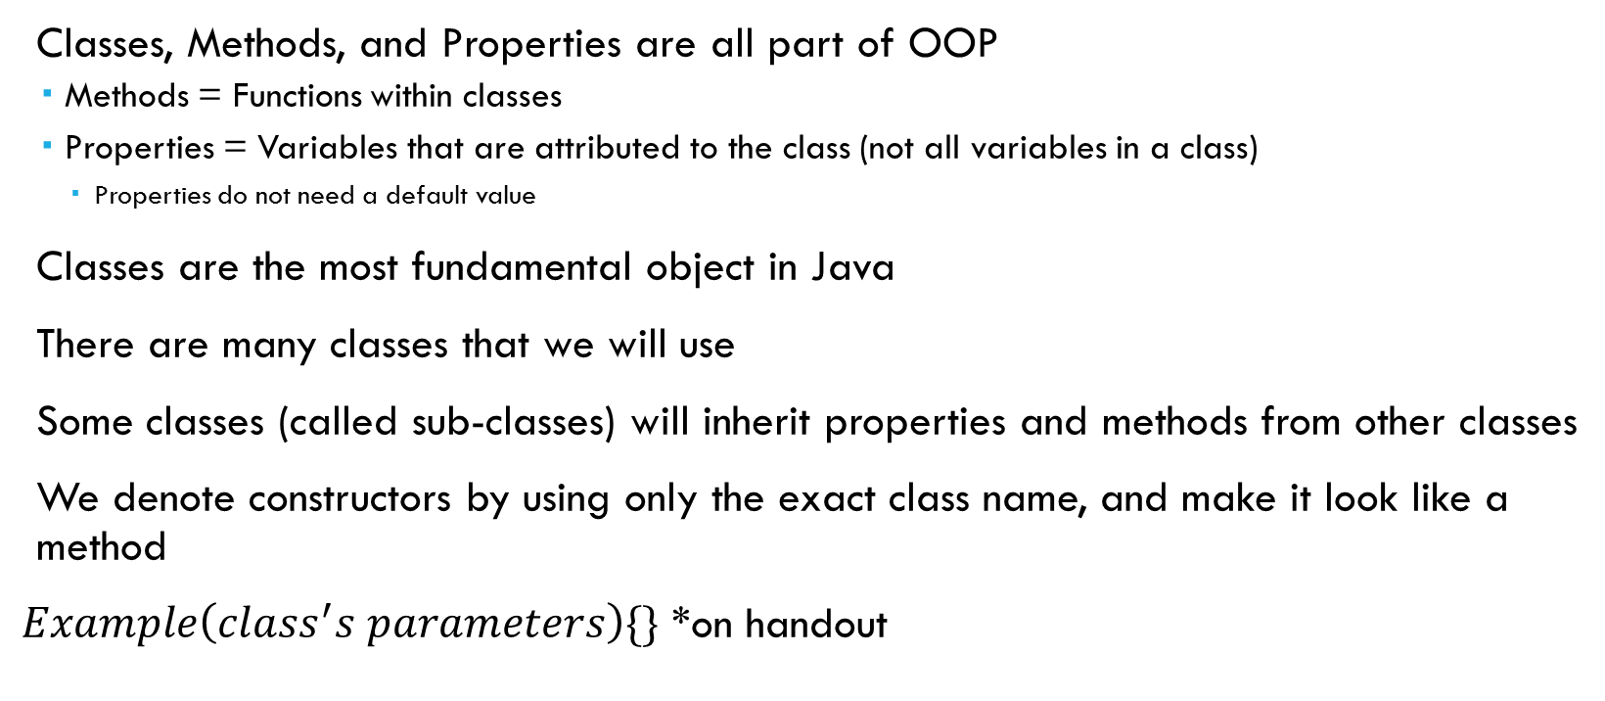
Object oriented programming (OOPs)
Classes, Methods, and Properties are all part of OOP
Methods = Functions within classes
Properties = Variables that are attributed to the class (not all variables in a class)
Properties do not need a default value
Classes are the most fundamental object in Java
There are many classes that we will use
Some classes (called sub-classes) will inherit properties and methods from other classes
We denote constructors by using only the exact class name, and make it look like a method
$Example\left(class^{′}s parameters\right)\{\}$ *on handout
Notes:
Anyclass objName = Anyclass(); (Declaring an object variable)
How about packages?
What does a constructor do?

Slide 12
Variable scope and object Inheritance
Different types of variable scope change the visibility of object elements to other objects
Classes can inherit attributes from “super classes,” to become “sub classes”
Animal
Cat
Dog
We can access visible object attributes by using “dot notation” within our code
Notes:
Cat and Dog are different, but they are both Animals, therefore they can extend the Animal class

Slide 13
Conditional Statements, calls, iterations
Conditionals are true or false statements
A conditional call returns true or false by whether or not the condition is true
An iteration runs a block of code over and over again until the condition becomes false
Conditional Operators:
“!” This is the “not” operator, it inverts a conditional
<, <=, >, >= are valid operators also
“==” This is opposed to the single equals, which is an assignment operator
We can nest conditionals into one conditional
“||” This is the “or” operator which connects one conditional statement to another, the whole conditional will return true if either one returns true
“&&” This is the “and” operator, same as or, but the whole conditional will only return true if both are true
Notes:
E.G. TRUE && TRUE = TRUE,
TRUE && FALSE = FALSE,
TRUE || FALSE = TRUE,
1 > 0 = TRUE,
1 < 0 = FALSE

Slide 14
Programming norms
Naming conventions
Comment conventions
Debugging and ease-of-change

Slide 15
Naming Conventions
In programming, we define class names with a capital letter (e.g. class Robot)
Sometimes underscores to denote spaces are okay, but we won’t use those (mostly because of Robot Builder), we will use caps (createOne)
First letter should be lowercase on everything other than classes
Name lengths should be one or two words max.

Slide 16
Comment conventions
Anytime you feel there is ambiguity as to what you are doing, you should clarify with a comment.
If you create a function that was not automatically added by Robot Builder, then you should always comment on that function to clarify at least once.
DON’T DELETE DEFAULT COMMENTS OR WRITE CODE BETWEEN AUTOGENERATED COMMENTS
// BEGIN AUTOGENERATED CODE and // END AUTOGENERATED CODE
Comments should be only about programming (i.e. no messages back and forth)

Slide 17
Debugging / Ease of Change
NEVER convert to old versions of code for testing
Should all constants in the program be available in a table of super-global constants or a single super-global array?
Easy change of global constant for testing.
But, accessing a variable is slightly more complicated
Method of making one super-global array or table
Notes:
Talk about the concept of arrays, and the methodical approach to building a super-global constant array

Slide 18
Software Architecture
How our code will work

Slide 19
What is SOFWATE Architecture?
Software architecture (SA) is the method in which we, essentially, utilize objects in our code.
Some methods of SA are not modularized– in other words, they may only run on one class
Modularization is the use of objects to compartmentalize functions, rather than to run one huge function over and over

Slide 20
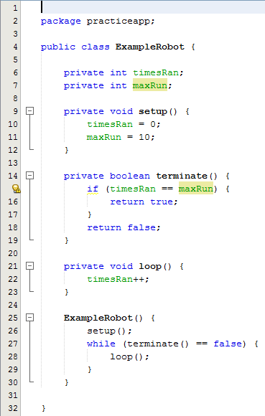
Basic Architecture example
On an Arduino, the architecture looks similar to this:
Notice, only one class, and one loop. This is fine for small projects, but this is larger and should be more straightforward and modularized
Notes:
Arduino is a single board micro controller system that is self programmable

Slide 21
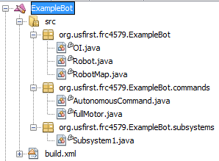
Our Software Architecture
We will use Modularized Command Based Programming
This means that we will separate a lot of what we do into subclasses, and other classes.
Robot Builder modularizes our programming automatically for the most part (generates the Command classes and the classes for controllers, etc.)
Hierarchy:
Systems (the robot)
Subsystems (motor controllers, PID subsystems,
I/O Devices
Commands

Slide 22
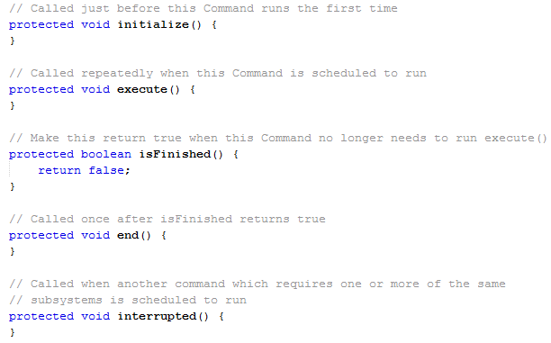
Command Architecture
Notes:
How does this class iterate?
Commands are similar to the Arduino concept, just at a more specified level

Slide 23
Four Components to our programming team
Robot
Smart Dashboard
Vision Processing (tentative)
Cypress Programmable System on-chip (PSOC) – Auxiliary I/O

